Slide 1
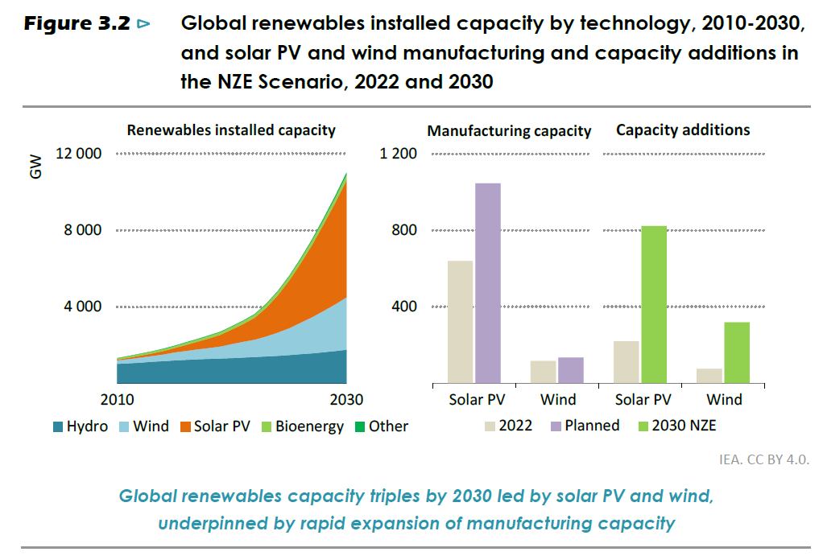
Massive increases in green investment required by 2030

Slide 2
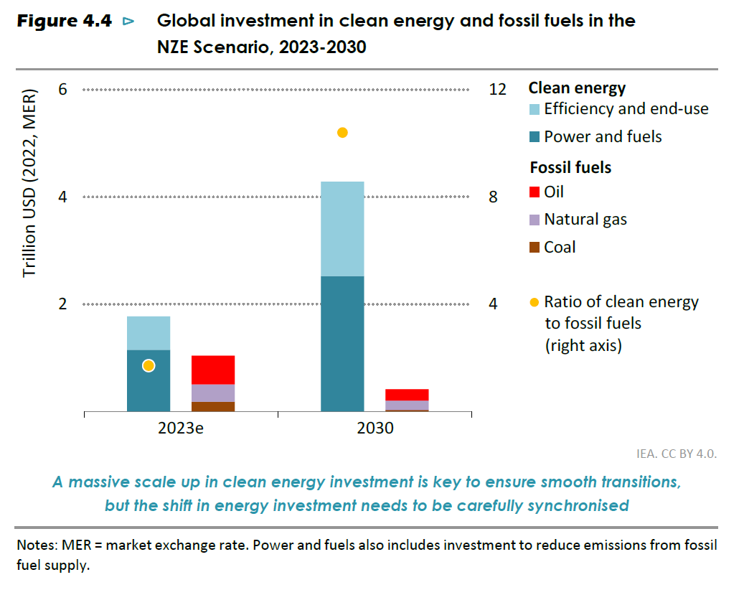
Green energy investment needs to increase rapidly to make the NZE a reality

Slide 3
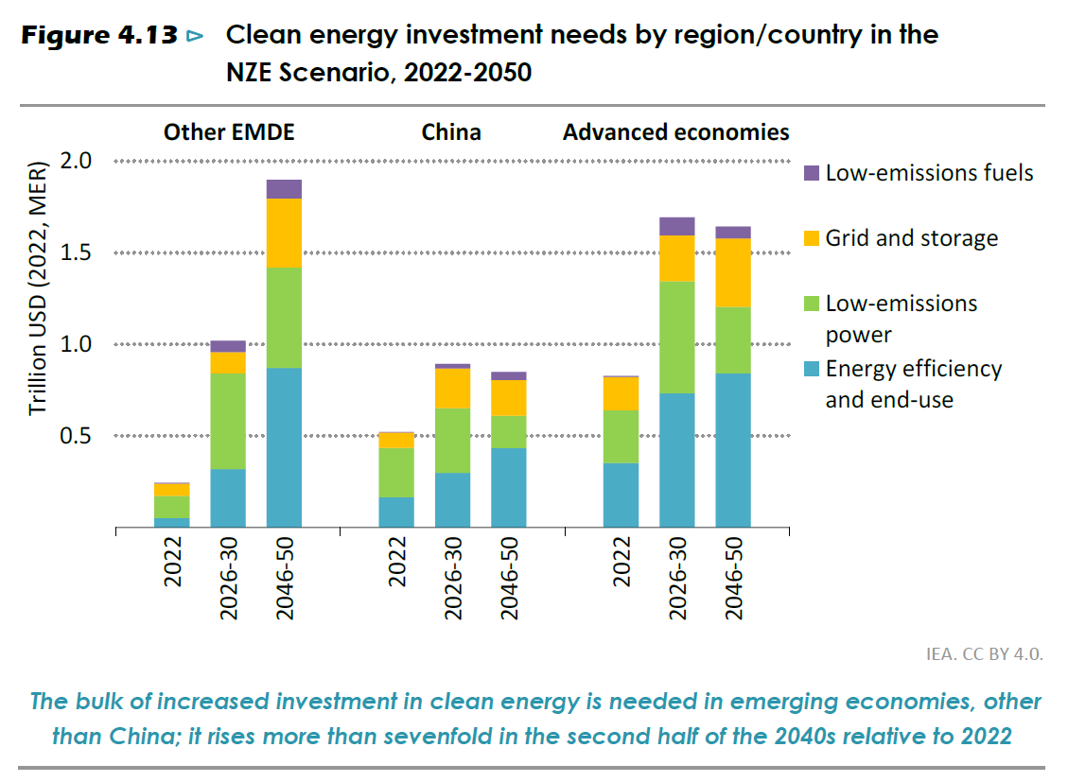
Bulk of increase in green investment is needed in emerging economies, excluding China

